Slide 1


Business Intelligence
BADM 557 Group 1 Presentation

Slide 2

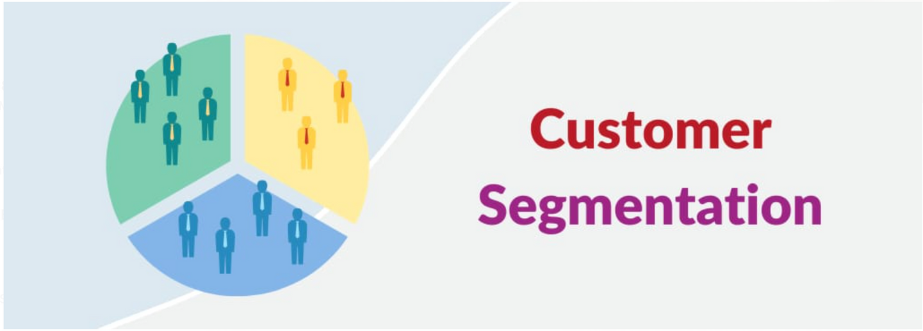
Introduction
Problem Statement -
Understanding customer purchases based of previous spendings and segmenting users

Slide 3


Scope and Objectives
Exploratory Data Analysis
Variable Selection
K-means Clustering
Cluster Profiling and Outcomes

Slide 4
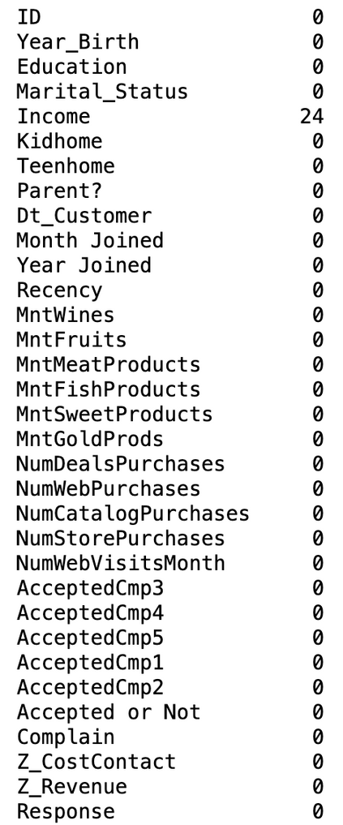
Exploratory Data Analysis
Step 1 - Summary Statistics
Step 2 - Unique values in categorical columns
Step 3 - Dealing with Outliers
Step 4 - Null Values
Step 5 - Imputing Null values

Slide 5
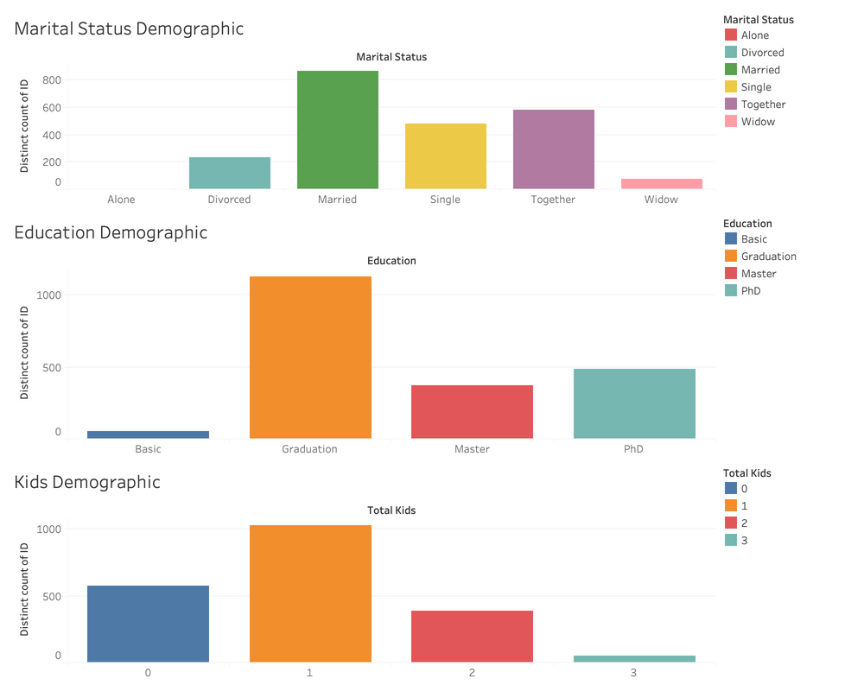
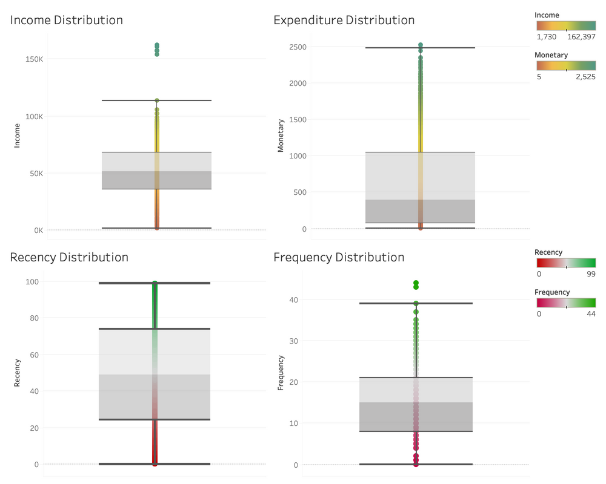
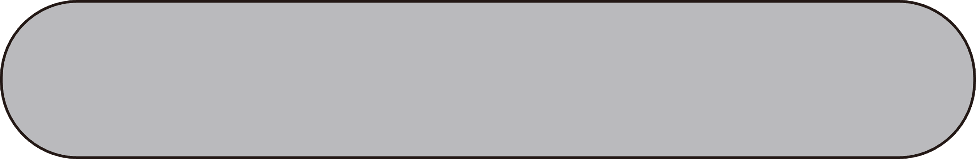
Feature Engineering and Variable Selection
Demographics
Income and Expenditure Distribution

Slide 6
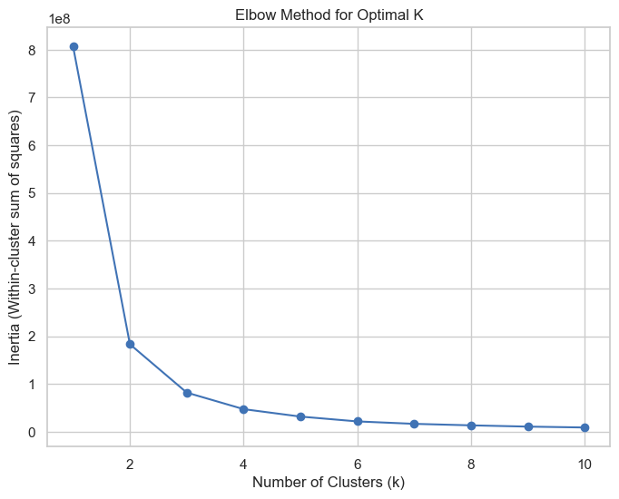


K-means Clustering
Finding Optimal Number of Clusters
Variables considered
Recency
Frequency
Monetary
The Elbow Tip is between 2 to 4

Slide 7
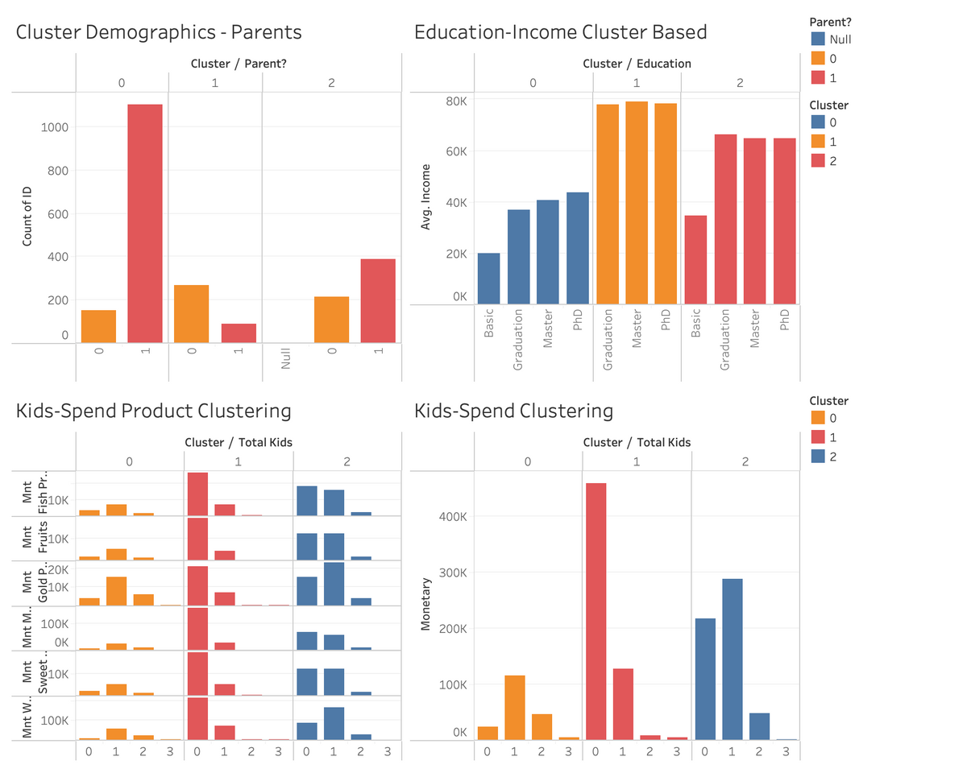
Cluster Profiling
Types of Demographics observed
Parents
Education
Income
Spend Analysis based on House hold size

Slide 8
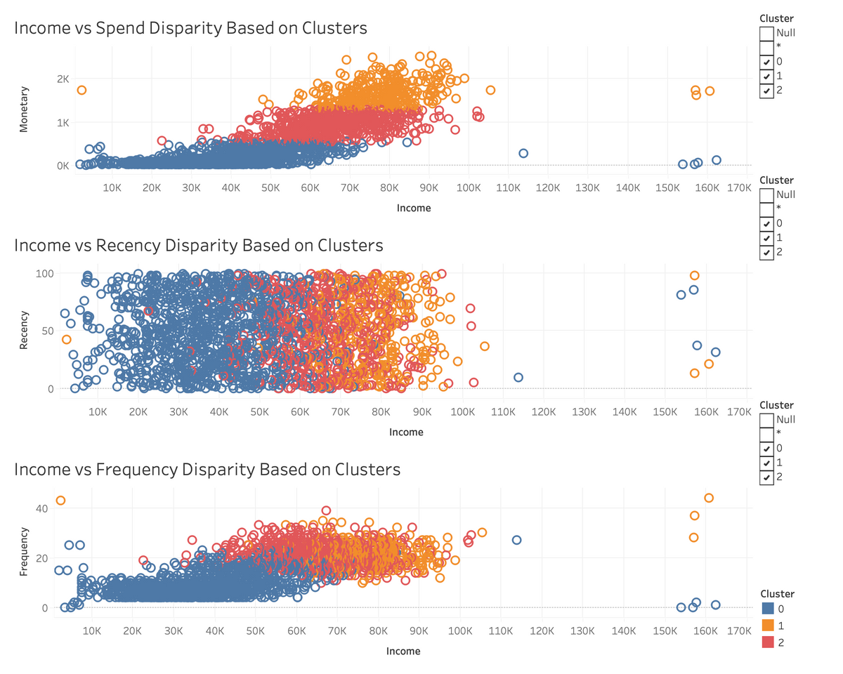
Clustering Outcomes
Income vs RFM
Each cluster defines a different distribution
Similarities between Spend and Frequency distribution
Observed normal distribution in Recency

Slide 9
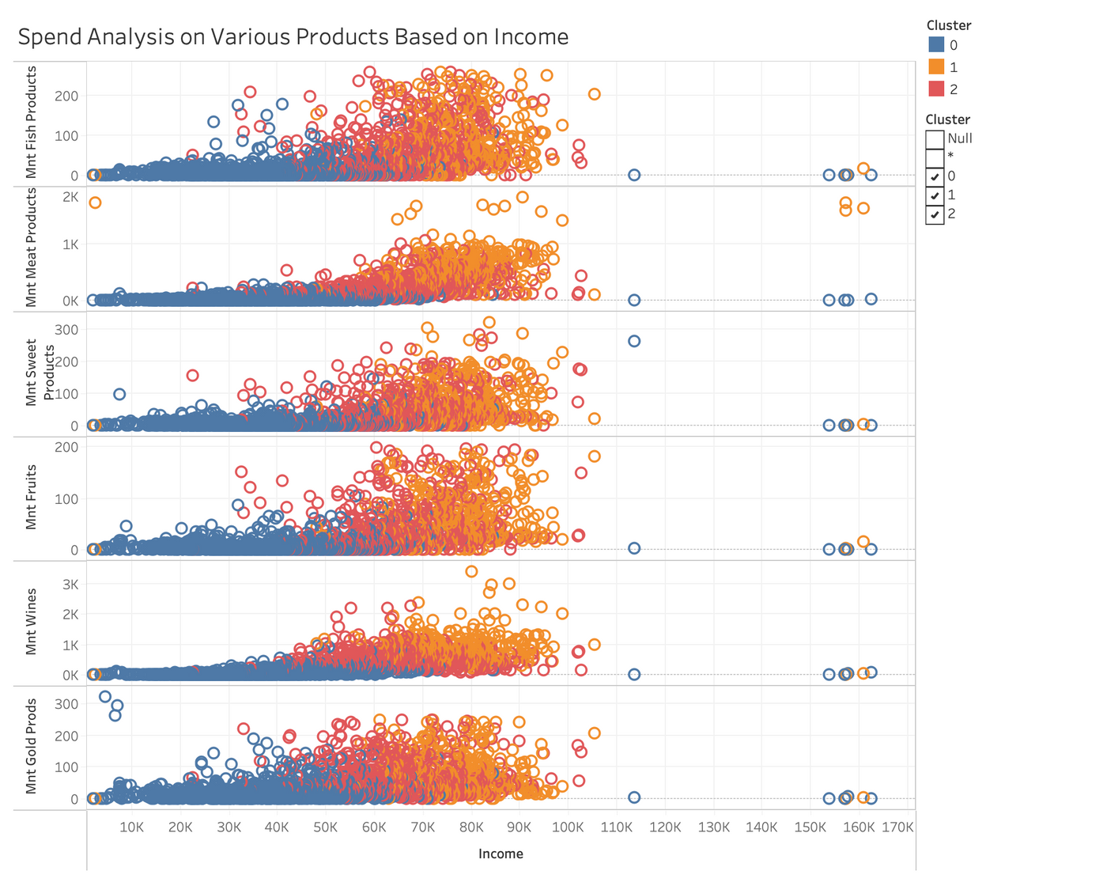
Clustering Outcomes
Income vs Spend of Each Product
We see the distribution of various products bought to be quite similar over the income range for different clusters

Slide 10
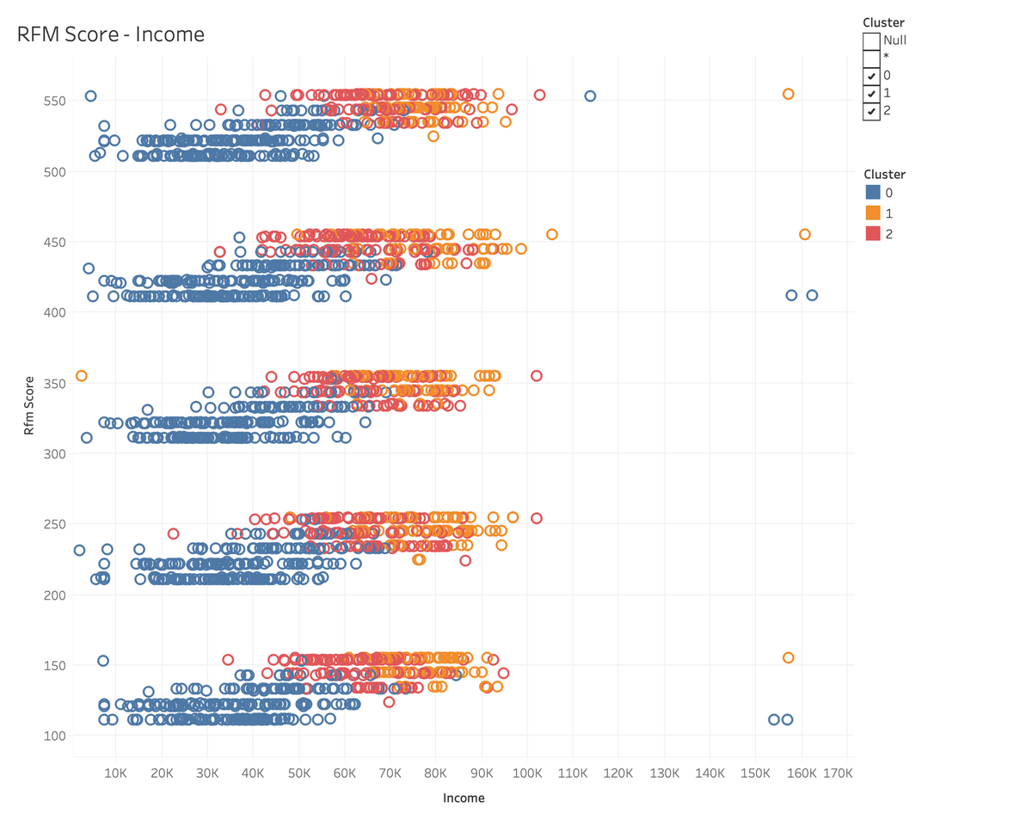
Clustering Outcomes
Income Vs RFM Score
Each cluster has values in various RFM ranges for different income ranges in each cluster

Slide 11
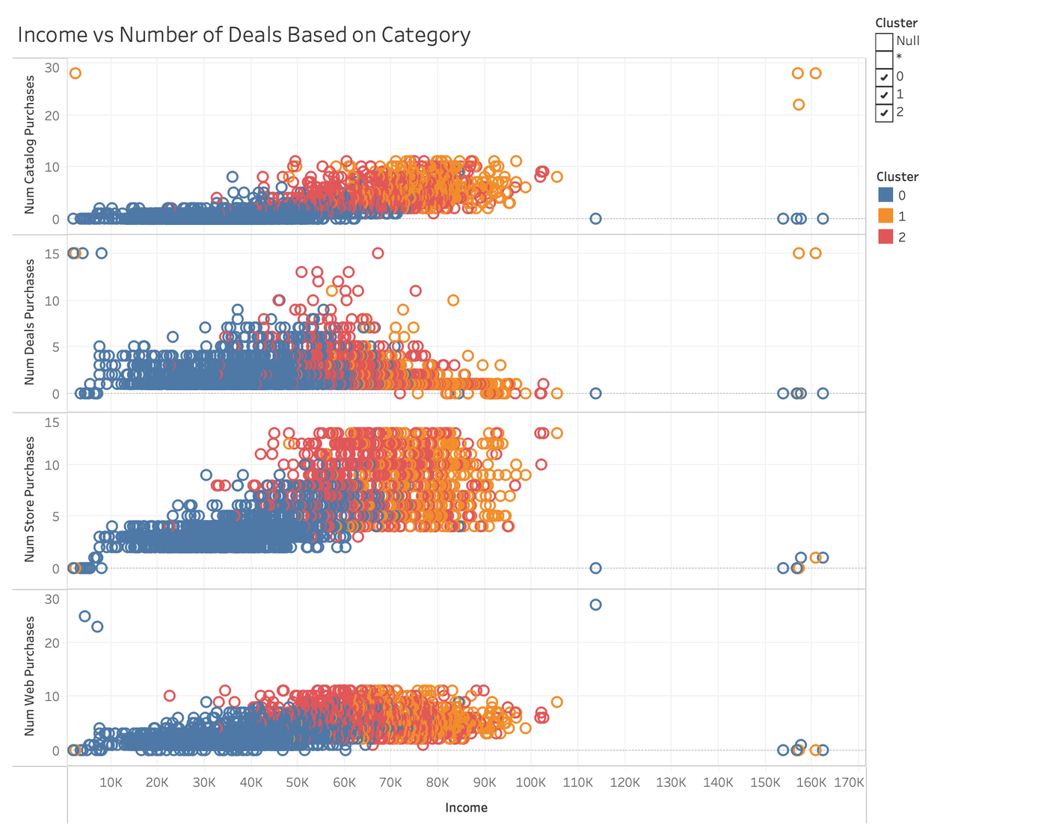
Clustering Outcomes
Income Vs Number of Categorical frequencies
Catalog and Web purchases show similar distribution
We see that with the increase in income the number of deal purchases have dropped but the store purchases have increased

Slide 12
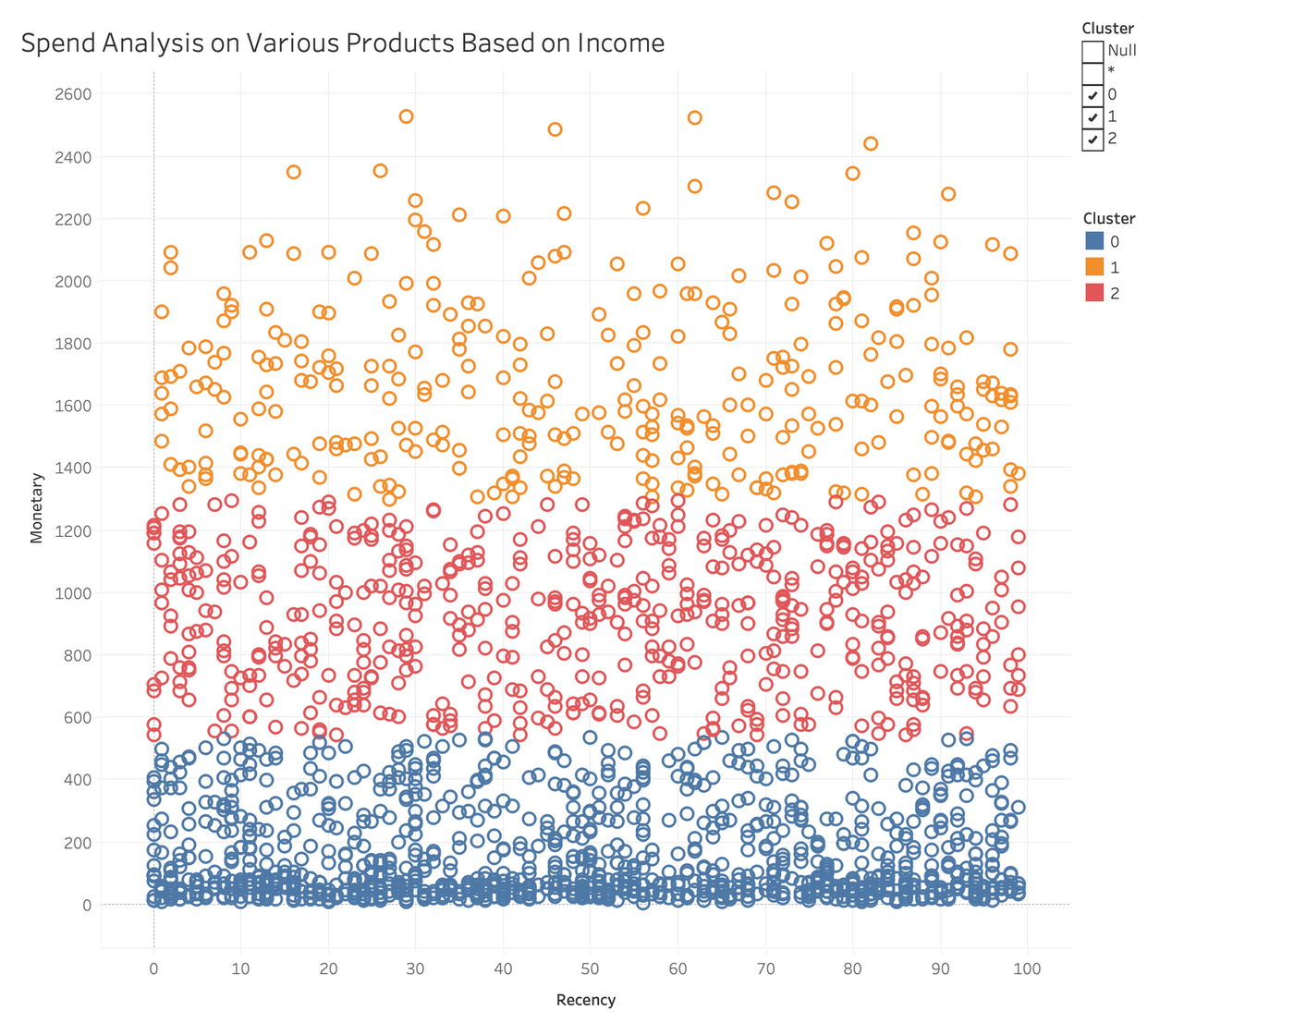
Clustering Outcomes

Slide 13

Conclusion
Cluster 0 (Low-Spending, Infrequent Customers)
Demographics: Average age 57, mostly married, moderate income ($70,000), graduation-level education.
Spending Trends: Prefers wines, but overall spends minimally across all categories.
Insights: Indicates budget constraints or low brand engagement.

Slide 14
Conclusion
Cluster 1 (High-Spending, Frequent Customers)
Demographics: Demographics: Similar age and marital status to Cluster 0, slightly lower income ($66,000), primarily graduates.
Spending Trends: Spending Trends: High expenditure on premium products, especially wines and meat & fish..
Insights: Lifestyle likely includes entertaining; shows high brand loyalty and preference for quality.

Slide 15
Conclusion
Cluster 2 (Moderate-Spending, Frequent Customers)
Demographics: Comparable age and marital status to other clusters, average income ($65,000), mostly graduates.
Spending Trends: Balanced spending across various categories, with a slight focus on wines and meat & fish.
Insights:Demonstrates diverse interests and potential for targeted upselling.

Slide 16
Questions?

Slide 17
Thank You!
Team -
Dwijesh Reddy
Nikhil Nagendra
Nikhil Reddy
Saniya Shah
Vyshnavi Gokavarapu

